Slide 1

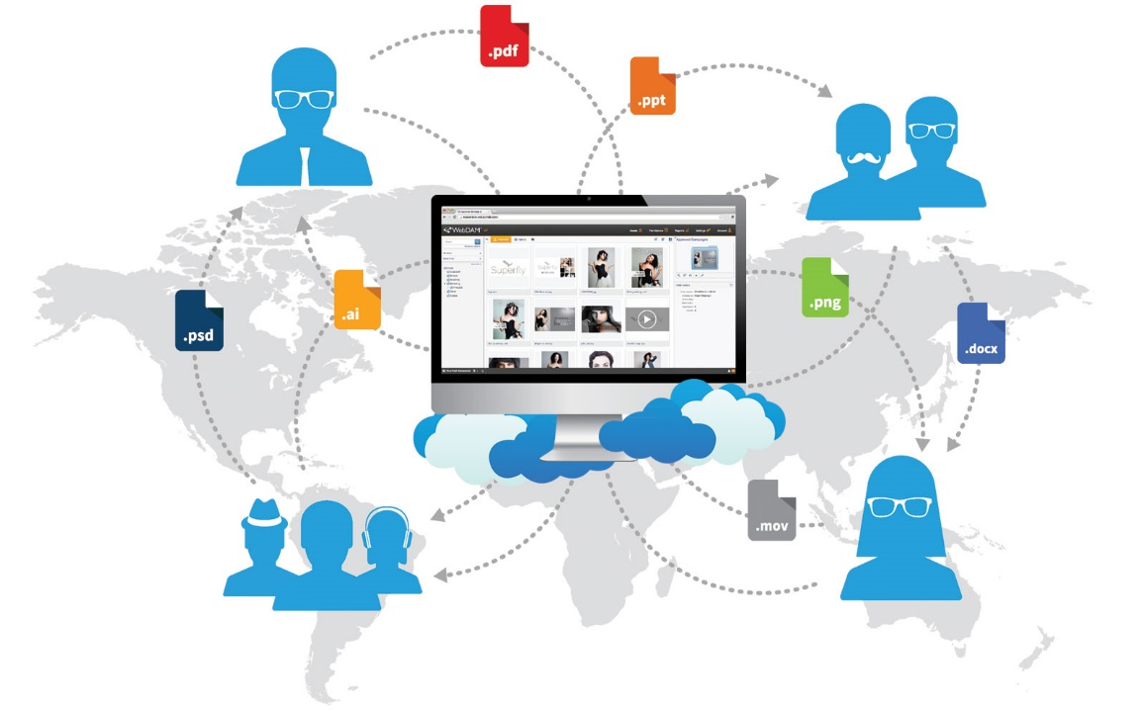


Evaluation Recommendation
Continuous Delivery Tools – Jan 2018
Lead Architect: Pavan Thotireddy Project Manager: Kimberly Willis
Version 1.0
© 2016 AT&T Intellectual Property. All rights reserved. AT&T and the AT&T logo are trademarks of AT&T Intellectual Property. AT&T Proprietary (Internal Use Only). Not for use or disclosure outside the AT&T companies except under written agreement.

Slide 2

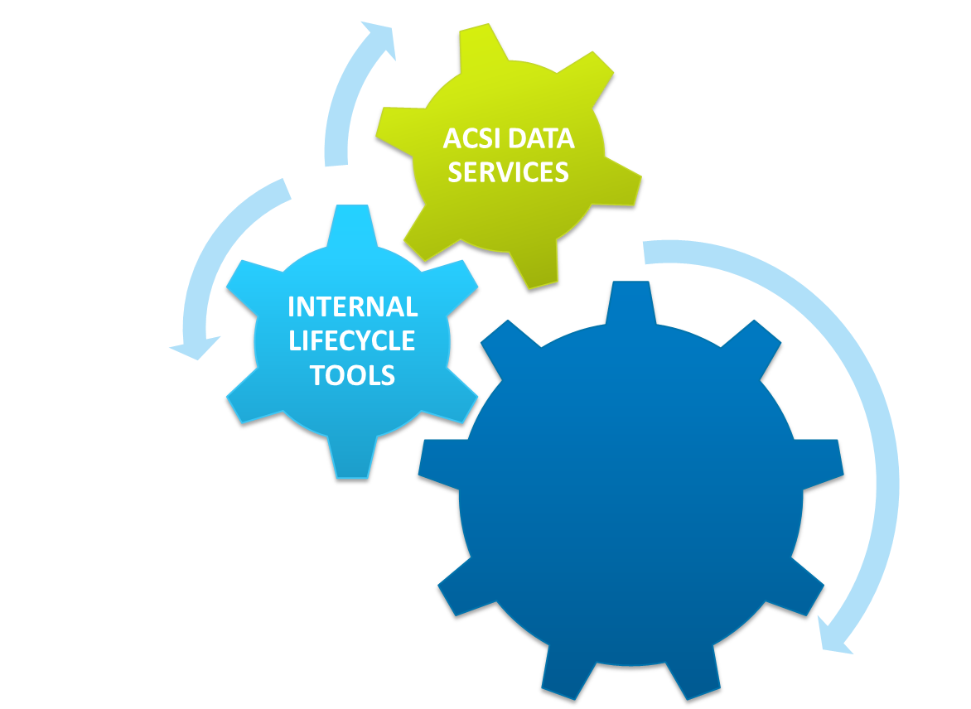
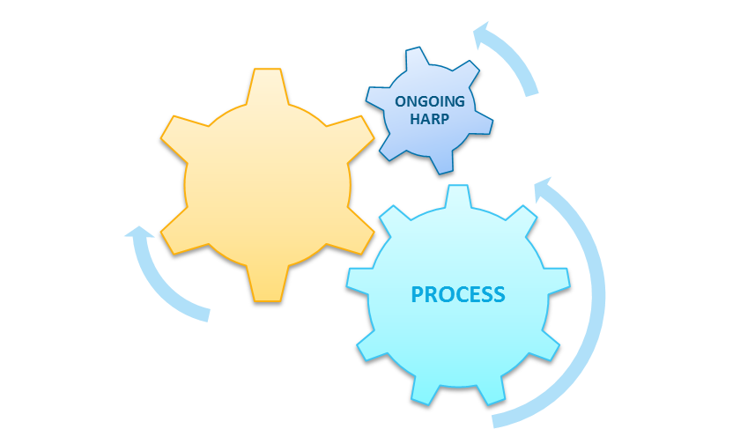
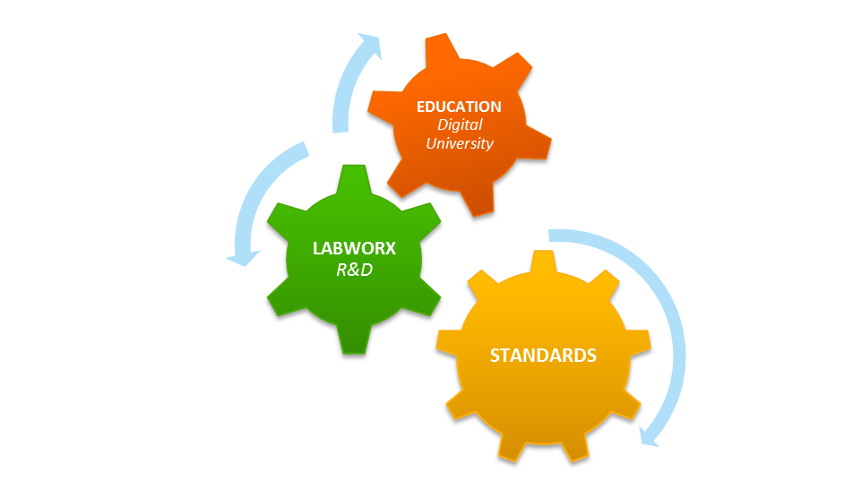



One Digital Platform that offers multiple optimized & connected experiences.
THE DIGITAL ECOSYSTEM
All Assets, All Capabilities
COMMUNICATION
ENGINES
FRAME-
WORKS
INFRA-
STRUCTURE
© 2015 AT&T Intellectual Property. All rights reserved. AT&T and the AT&T logo are trademarks of AT&T Intellectual Property. AT&T Proprietary (Internal Use Only). Not for use or disclosure outside the AT&T companies except under written agreement.

Slide 3


Lead Architect - Pavan Thotireddy
    Areas of Expertise:
15 Years of designing & delivering highly scalable & reliable e-Commerce applications:
    Disney merchandise e-Commerce site – 3 Years
    myAT&T Sales – 10 Years
DevOps Tools & Processes – 4 Years
    Major Digital Experience projects:
  Wireline Buyflow Consolidation Project
  Hardrock Desktop & Mobile for AT&T Mobility
  iPhone Iconic launches
  DevOps Maturity Model and Application Assessments
  CI/CD Tools evaluations
AT&T Experience
AT&T since 2006
Online since 2006
© 2015 AT&T Intellectual Property. All rights reserved. AT&T and the AT&T logo are trademarks of AT&T Intellectual Property. AT&T Proprietary (Internal Use Only). Not for use or disclosure outside the AT&T companies except under written agreement.

Slide 4

Agenda
    Enabler Scope & Objectives
    Evaluation & Selection Approach
    Client & Key Stakeholders
    Key Capabilities
    Test-Drive Use Cases
    Products Evaluated
    Findings & Analysis
    Evaluation Scorecard
    Evaluation Summary & Recommendation
    Q & A
© 2015 AT&T Intellectual Property. All rights reserved. AT&T and the AT&T logo are trademarks of AT&T Intellectual Property. AT&T Proprietary (Internal Use Only). Not for use or disclosure outside the AT&T companies except under written agreement.

Slide 5
Enabler Scope & Objectives
    Scope
    Evaluate, select and recommend automation and orchestration tools that enable daily delivery of code and defect fixes to production for Digital Experience applications by automating end-to-end process from code check-in, build creation, regression testing, deployment to any environment and release to production, without sacrificing quality
    Key Objectives
    Ability to streamline and automate build, test, deliver and deploy code to production to help achieve faster, frequent and reliable releases
    Reduces the cost for defect fixes through faster defect testing cycle and test automation
    Continuous Delivery tools Dashboard view will Improve communication, collaboration, and integration between developers, testers, and operations
    Ability to deploy on demand with complete control and transparency of the entire release pipeline
© 2015 AT&T Intellectual Property. All rights reserved. AT&T and the AT&T logo are trademarks of AT&T Intellectual Property. AT&T Proprietary (Internal Use Only). Not for use or disclosure outside the AT&T companies except under written agreement.

Slide 6
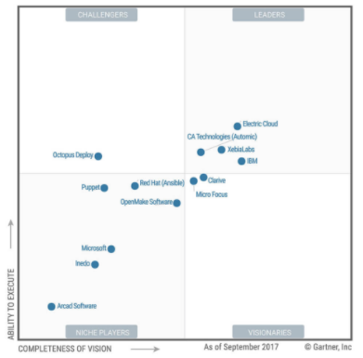
Evaluation & Selection Approach
INSERT CHART
    Workshops conducted with Clients & Key Stakeholders:
      Defined, categorized and prioritized Enabler key capabilities
      Identified test-drive use-cases
    Leading products in the market identified based on <Chart Source>, internal knowledge and other industry studies
    Deep-dives conducted with leading vendor candidates:
      Electric Cloud
      Xebia Labs
      CA Automic
      ATT ECO
    Vendor candidates short-listed:
      Electric Cloud – Electric Flow: Great product with extensive features
      Xebia Labs – XL Deploy & XL Release: Great product but two product required and less K8 support
    Products selected after evaluation:
      Electric Cloud – Electric Flow
    Scorecard created based on prioritized capabilities from Clients & Key Stakeholders
Chart from Gartner on 2017
© 2015 AT&T Intellectual Property. All rights reserved. AT&T and the AT&T logo are trademarks of AT&T Intellectual Property. AT&T Proprietary (Internal Use Only). Not for use or disclosure outside the AT&T companies except under written agreement.

Slide 7
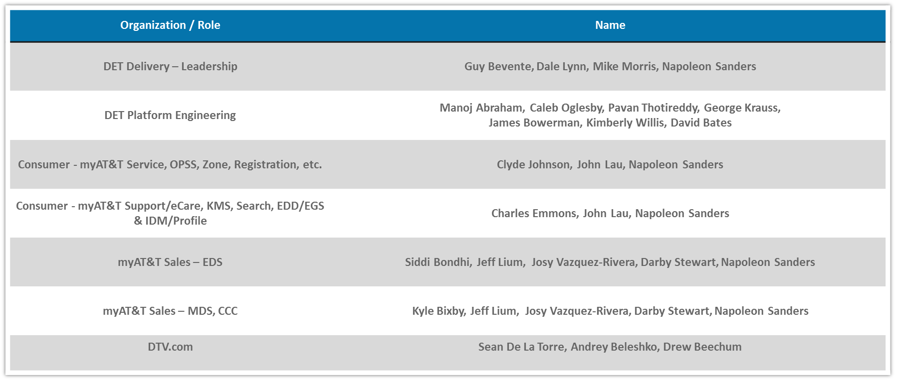
Client & Key Stakeholders
Strong partnership and collaboration across functional teams.
© 2015 AT&T Intellectual Property. All rights reserved. AT&T and the AT&T logo are trademarks of AT&T Intellectual Property. AT&T Proprietary (Internal Use Only). Not for use or disclosure outside the AT&T companies except under written agreement.

Slide 8
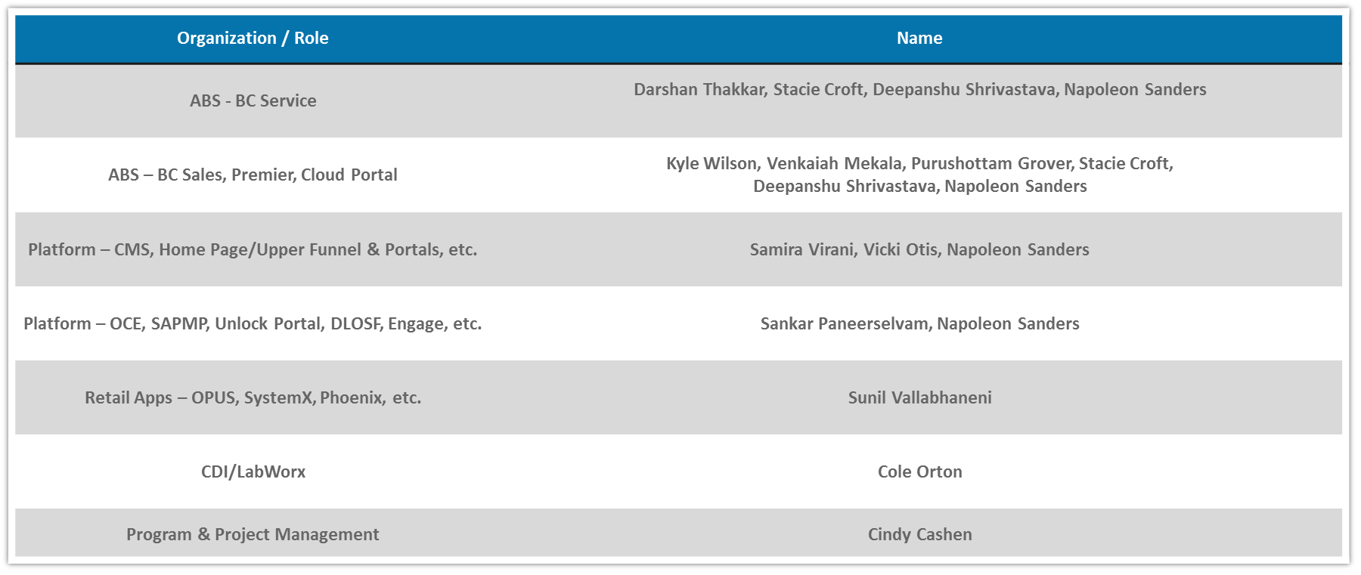
Client & Key Stakeholders Cont.
Strong partnership and collaboration across functional teams.
© 2015 AT&T Intellectual Property. All rights reserved. AT&T and the AT&T logo are trademarks of AT&T Intellectual Property. AT&T Proprietary (Internal Use Only). Not for use or disclosure outside the AT&T companies except under written agreement.

Slide 9
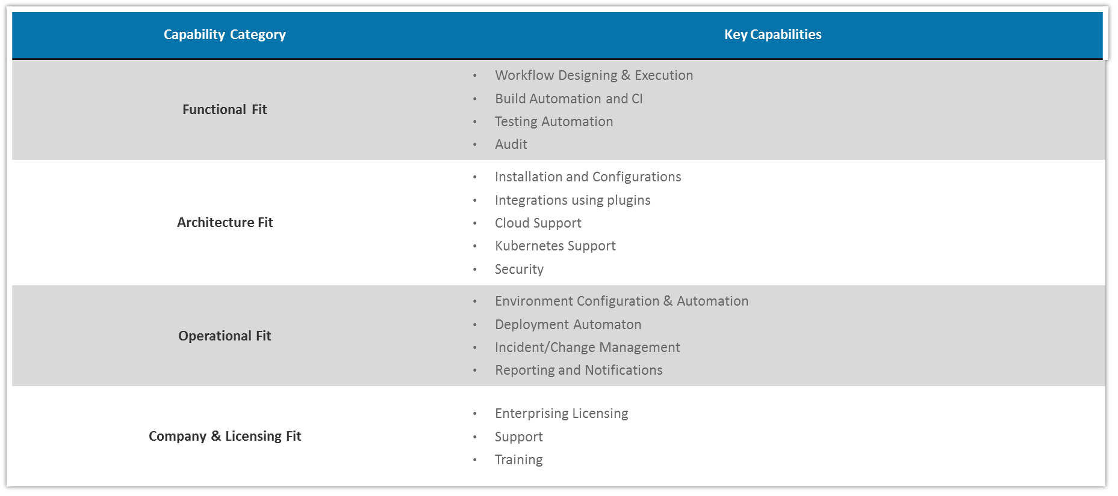
Key Capabilities
© 2015 AT&T Intellectual Property. All rights reserved. AT&T and the AT&T logo are trademarks of AT&T Intellectual Property. AT&T Proprietary (Internal Use Only). Not for use or disclosure outside the AT&T companies except under written agreement.

Slide 10
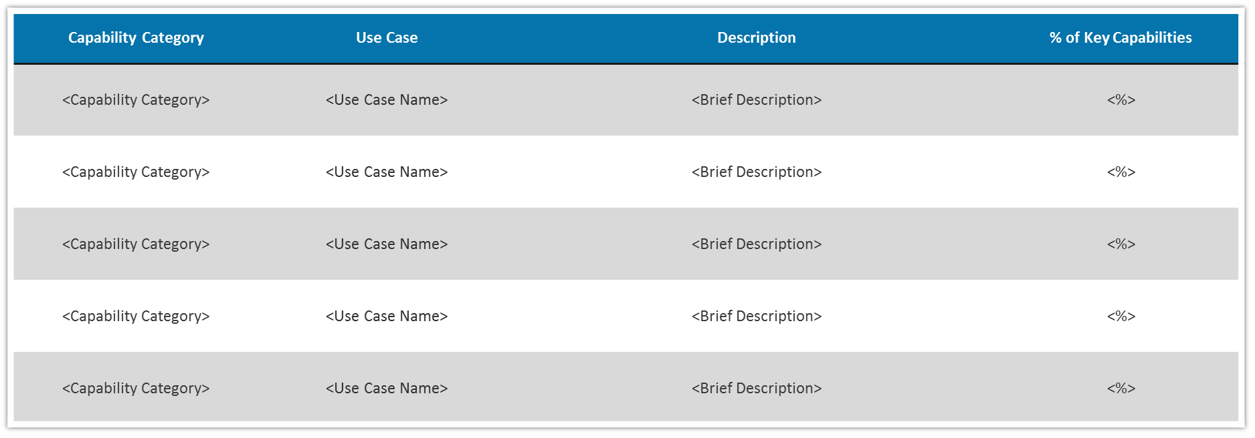
Test-Drive Use Cases
© 2015 AT&T Intellectual Property. All rights reserved. AT&T and the AT&T logo are trademarks of AT&T Intellectual Property. AT&T Proprietary (Internal Use Only). Not for use or disclosure outside the AT&T companies except under written agreement.

Slide 11
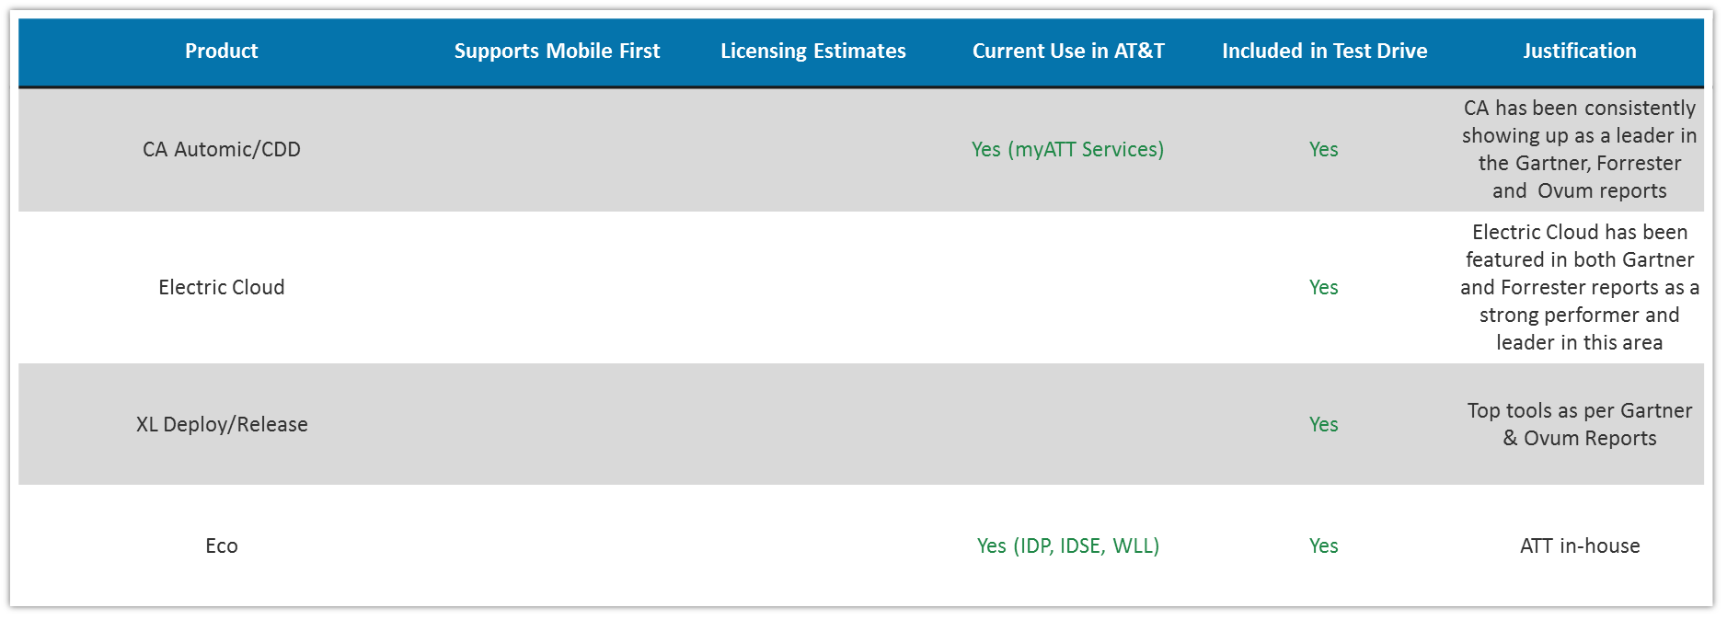

Products Evaluated
CURRENT STATE: | Eco is an internally developed tool within AT&T, and is gaining popularity with its CDP integration and Micro services focus. Not all the tools listed are currently used in ATT
PLATFORM GOAL: | Provide the recommendation based on the paper evaluation followed by the test drive.
© 2015 AT&T Intellectual Property. All rights reserved. AT&T and the AT&T logo are trademarks of AT&T Intellectual Property. AT&T Proprietary (Internal Use Only). Not for use or disclosure outside the AT&T companies except under written agreement.

Slide 12
Findings & Analysis
  CA Automic/CDD
  Electric Cloud
  XL Deploy/Release
  ATT Eco
  Pros:
      Release, Calendar, Dashboard view available
      Kubernetes plugin is available
      Automic and CDD both supports workflows
      Rollback facility is available
  Cons:
      ARA only supports on Windows
      Kubernetes plugin support is not having extensive features.
      DSL support is not available
      Less Plugins available
  Pros:
      Ample plugins available
      Continuous Delivery & Release Automation are available within one tool/setup.
      Release, Calendar, Dashboard view available
      DSL support available
      Kubernetes plugin is available
      Rollback facility is available
  Cons:
      No dashboard available for test results.
      Agent required for Weblogic/JBOSS deployments.
  Pros:
      Ample plugins available
      Easy customization for plugin, as code is available on Github
      Calendar and release options are available
      Great support is available
      DSL Support is available
  Cons:
      SSH required to connect
      Both XL Release and XL Deploy is required
      Complete Kubernetes support is not available
  Pros:
      ATT in-house, no cost associated.
      FREE
      Basic structuring of the project with CI/CD is available using ECO templates
      ECO Jenkins Or our own Jenkins can be used with ECO
  Cons:
      This tool is specifically for microservices only.
      No release dashboards are available.
      Only DSL support, no drag/drop in UI is available for workflows
  CONCLUSIONS:
      CA Automic- Great product but complex in usage
      Xebia Labs – Great support and easy customization but lack in features for K8
      Electric Cloud – Great product with better support for K8 and easy to use
      ATT ECO – Great for microservices and freely available
© 2015 AT&T Intellectual Property. All rights reserved. AT&T and the AT&T logo are trademarks of AT&T Intellectual Property. AT&T Proprietary (Internal Use Only). Not for use or disclosure outside the AT&T companies except under written agreement.

Slide 13
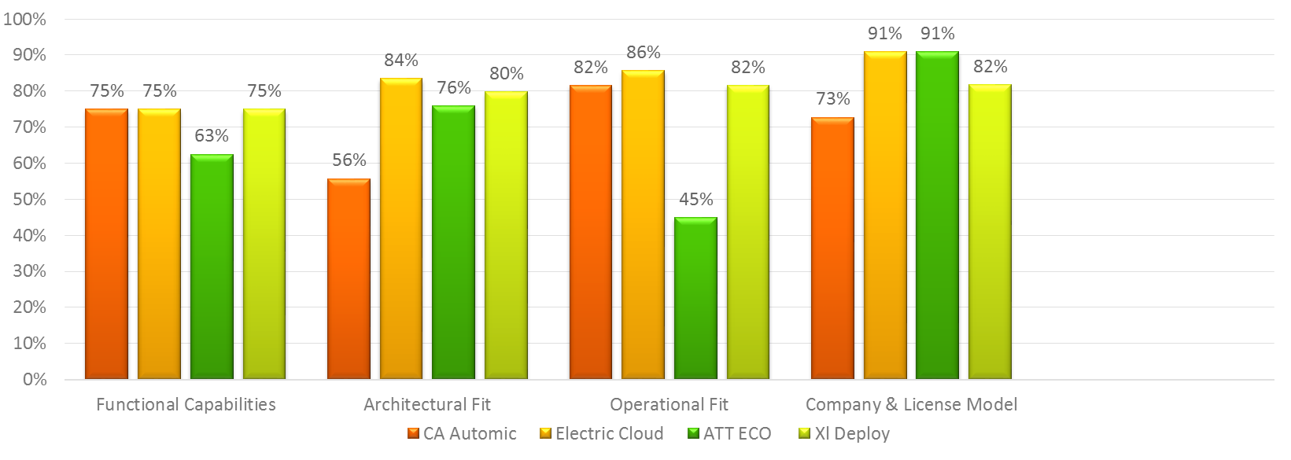
Evaluation Scorecard
  Summary:
  <Results summary>
  SCORE WEIGHTS
  BY CATEGORY:
Company & Licensing Fit | <%>
Architectural Fit | <%>
Functional Fit | <%>
Operational Fit | <%>
© 2015 AT&T Intellectual Property. All rights reserved. AT&T and the AT&T logo are trademarks of AT&T Intellectual Property. AT&T Proprietary (Internal Use Only). Not for use or disclosure outside the AT&T companies except under written agreement.

Slide 14
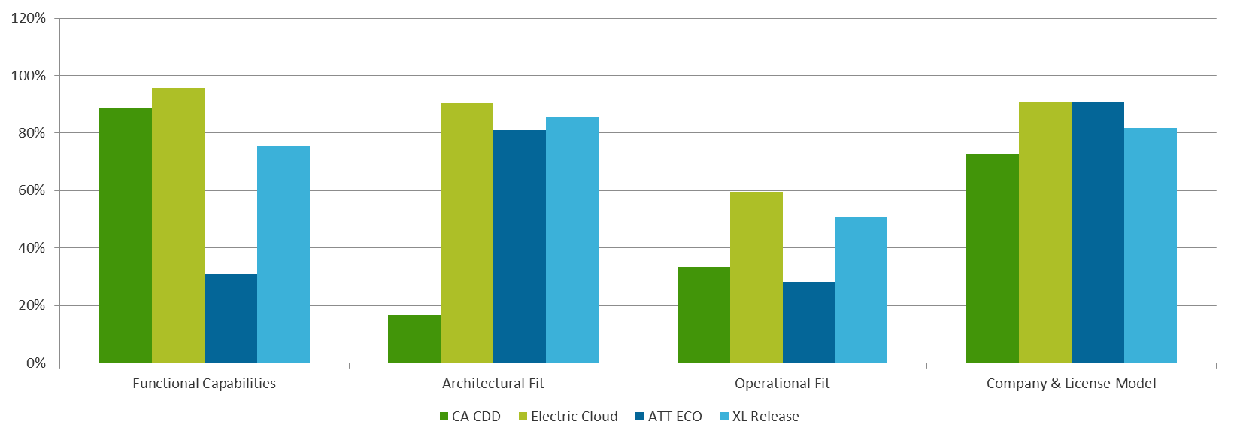
Evaluation Scorecard
Add chart from finalized Capability Matrix
  Summary:
  <Results summary>
  SCORE WEIGHTS
  BY CATEGORY:
Company & Licensing Fit | <%>
Architectural Fit | <%>
Functional Fit | <%>
Operational Fit | <%>
© 2015 AT&T Intellectual Property. All rights reserved. AT&T and the AT&T logo are trademarks of AT&T Intellectual Property. AT&T Proprietary (Internal Use Only). Not for use or disclosure outside the AT&T companies except under written agreement.

Slide 15


Summary & Recommendation
Electric Flow is the recommended selection
ElectricFlow
#1
    AT&T evaluation score of <Score>
    Better product with ample of features for both monolithic and microservices
    Better licensing model and cheaper then other
    Great support from the vendor while test drive
#2
Xebia Labs
    AT&T evaluation score of <Score>
    Great product with great features
    Easy customization as plugin code is available on Github
© 2015 AT&T Intellectual Property. All rights reserved. AT&T and the AT&T logo are trademarks of AT&T Intellectual Property. AT&T Proprietary (Internal Use Only). Not for use or disclosure outside the AT&T companies except under written agreement.

Slide 16
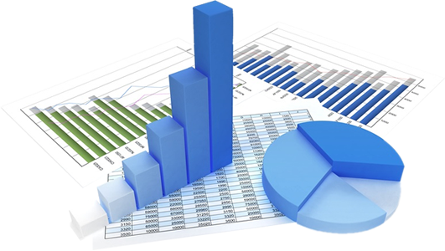
QUESTIONS?
© 2015 AT&T Intellectual Property. All rights reserved. AT&T and the AT&T logo are trademarks of AT&T Intellectual Property. AT&T Proprietary (Internal Use Only). Not for use or disclosure outside the AT&T companies except under written agreement.

Slide 17
APPENDIX
© 2015 AT&T Intellectual Property. All rights reserved. AT&T and the AT&T logo are trademarks of AT&T Intellectual Property. AT&T Proprietary (Internal Use Only). Not for use or disclosure outside the AT&T companies except under written agreement.

